Slide 1

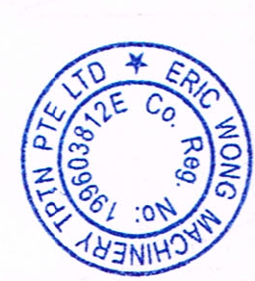
ERIC WONG MACHINERY TRANSPORTATION PTE LTD
28 Kranji Loop #05-03, Kranji Green, Singapore 739571
Tel: 62824175, 62828203, 62826020
GST Reg No. : M2-8923804-2
http://www.ericwong.com
E-mail: ewmtpl@gmail.com
Customer / Tenant Company: Singapore Mint
Site Location: 25 Bulim Square | Approved By: Eric Wong (Director)
Process: Lifting and Moving of Machinery on Platform
Prepared by: Kevin Wong
Last Review Date: 24.02.2025 | Next Review Date: 23.02.2026
Method Statement,
Lifting Plan and
Safe Work Procedure
For Lifting and Machinery Moving Operation

Slide 2
ERIC WONG MACHINERY TRANSPORTATION PTE LTD
28 Kranji Loop #05-03, Kranji Green, Singapore 739571
Tel: 62824175, 62828203, 62826020
GST Reg No. : M2-8923804-2
http://www.ericwong.com
E-mail: ewmtpl@gmail.com
Customer / Tenant Company: KY Sub Assembly Pte Ltd
Site Location: 25 Bulim Square | Approved By: Eric Wong (Director)
Process: Lifting and Moving of Machinery on Platform
Prepared by: Kevin Wong
Last Review Date: 24.02.2025 | Next Review Date: 23.02.2026
Contents Pages
1.0 Workplace Safety and Health in the Workplace 2
2.0 Objectives 2
3.0 Scope 2
4.0 Responsibility 2
5.0 Site Survey 4
6.0 Risk Assessment 4
7.0 Classifications of Lifts Types 4
8.0 Routine Lifts 5
9.0 Non-Routine Lifts 6
10.0 A Non-Routine Lift is a lift which conforms to the following factors 8
11.0 Competent Person(s) 9
12.0 Supervisors 9
13.0 Operators /Riggers /Signalmen 10
14.0 Description of Load(s) to be lifted 10
15.10 Centre of Gravity (CG) of the load 11
16.0 Crane Selection 11
17.0 Ground & Outriggers 11
18.0 Access & Lifting Location 12
19.0 A Pre-Start Meeting 12
20.0 Sequence of Lifting operation 13
21.0 Lifting operation checklist 26
22.0 Emergency procedures 27

Slide 3
ERIC WONG MACHINERY TRANSPORTATION PTE LTD
28 Kranji Loop #05-03, Kranji Green, Singapore 739571
Tel: 62824175, 62828203, 62826020
GST Reg No. : M2-8923804-2
http://www.ericwong.com
E-mail: ewmtpl@gmail.com
Customer / Tenant Company: KY Sub Assembly Pte Ltd
Site Location: 25 Bulim Square | Approved By: Eric Wong (Director)
Process: Lifting and Moving of Machinery on Platform
Prepared by: Kevin Wong
Last Review Date: 24.02.2025 | Next Review Date: 23.02.2026
1.0 Workplace Safety and Health in the Workplace
1.1 Under Workplace Safety And Health Act 2006 and its subsidiary legislations. Occupier/Employers are responsible for ensuring the safety and health of their employees and also the public, if they are at risk from those work activities.
1.2 This procedure is in general applicable to all project sites. It covers in detail about the procedures involved in lifting operation.
1.3 Occupier /Employer shall employ Workplace Safety and health Personnel with the aim of reducing the number of industrial accidents by enforcing the Law, providing advice on good working practices, and developing guidance in response to technical changes in equipment and working methods.
2.0 Objectives
2.1 To eliminate or minimize the level of near accidents, injury and damage to property during the lifting operation at worksite. Establish and maintain procedures for carrying out work safely and protect the safety and health of persons in the event of emergency.
3.0 Scope
3.1 To be communicated to personnel carrying out the work and follow the prescribed work procedures accordingly to workplace / worksite safety requirement in an acceptable manner.
4.0 Responsibility
4.1 Project Coordinator – Assist the Project Manager in achieving the OSH Management System, enforcing the OSH policy in accident prevention and compliance to the WSH Act. Provide support to the Safety section in accident prevention.
4.2 Site Supervisor – Responsible for assisting the Project Manager / Project Coordinator in implementing and enforcing the OSH policy in accident prevention. Compliance with the WSH Act (If required and ensure activities are carried out in accordance to this procedure)
4.3 Project Manager – Achieve the objectives of the OSH Management System, enforcing the OSH policy in accident prevention and compliance to the WSH Act. Provide support to the Safety section in accident prevention.

Slide 4
ERIC WONG MACHINERY TRANSPORTATION PTE LTD
28 Kranji Loop #05-03, Kranji Green, Singapore 739571
Tel: 62824175, 62828203, 62826020
GST Reg No. : M2-8923804-2
http://www.ericwong.com
E-mail: ewmtpl@gmail.com
Customer / Tenant Company: KY Sub Assembly Pte Ltd
Site Location: 25 Bulim Square | Approved By: Eric Wong (Director)
Process: Lifting and Moving of Machinery on Platform
Prepared by: Kevin Wong
Last Review Date: 24.02.2025 | Next Review Date: 23.02.2026
4.4 WSH Coordinator / Supervisor – Duties to ensure that the Regulations and Statutory requirements of WSH Act are complied. (Application of permit-to-work, conduct Tool box meeting and assist in the briefing and training of RA & SWP to workers).
4.5 Only trained workers are allowed to do the concreting work in the factory premise, worksite and other workplace which is deemed to be a factory.
5.0 Site Survey
5.1 To carry out a survey and to establish what the load to be lifted is, what all the characteristics are, weight, size, type of lifting lugs etc., what the ground conditions are, where it has to be lifted from and to, what the access route is like, etc. The survey must be completed by a competent person(s).
6.0 Risk Assessment
6.1 The site survey is an ideal time to begin a risk assessment of the proposed lifting operations that will be carried out. The aim of the risk assessment is to prevent incidents and/or accidents that arise from hazards* during the lifting operations. With the identified hazards, the risks posed by these hazards can be reduced to as low as reasonably practical through the implementation of control measures, using the principle of the hierarchy of controls.
6.2 Other potential hazards that may present a risk to the lifting operation from other activities in the vicinity should also be considered. This can be easily done during the site survey.
6.3 Examples of other hazards and associated risks include, narrow access, excavations, pipe-racks, overhead structures, other plant operating in the vicinity of the lifting area etc.
6.4 It is essential that the information within the risk assessment is translated into implementation on-site.
Checks should be done to ensure that control measures are in place and in good working condition.
6.5 As site conditions may change, the following table may be used to check that control measures Indicated in the risk assessments are put in place and that they remain applicable to the actual
7.0 Classifications of Lifts Types
7.1 There are generally two types of lift, Routine and Non-Routine. Categorising the type of lifts before planning the lift and documenting in a lifting plan is critical because it allows for the proper assessment of the amount of risk present in the lifting operation and the level of control required in mitigating the risks involved.

Slide 5
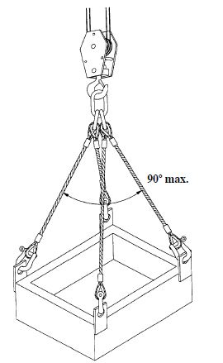
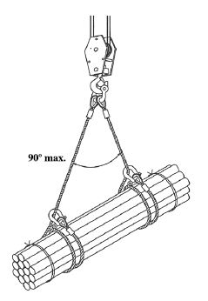
ERIC WONG MACHINERY TRANSPORTATION PTE LTD
28 Kranji Loop #05-03, Kranji Green, Singapore 739571
Tel: 62824175, 62828203, 62826020
GST Reg No. : M2-8923804-2
http://www.ericwong.com
E-mail: ewmtpl@gmail.com
Customer / Tenant Company: KY Sub Assembly Pte Ltd
Site Location: 25 Bulim Square | Approved By: Eric Wong (Director)
Process: Lifting and Moving of Machinery on Platform
Prepared by: Kevin Wong
Last Review Date: 24.02.2025 | Next Review Date: 23.02.2026
8.0 Routine Lifts
8.1 Routine lifting operations may be executed under a basic lift plan. These plans must clearly define the limitations on the loads, lifting methods and areas of operation. A Risk Assessment will be required in each case, and authorized prior to commencement. A Non-Routine may also be completed using similar documents but will require greater detail. Prior to any lifting operation commencing, a review of the lift plan must be conducted.
A Routine Lift is a lift which conforms to the following factors
Within the normal operating parameters of the crane
Lifting over non-sensitive areas
Suitable environmental conditions
Load has known and evaluated weight, shape and centre of gravity
Standard/Engineer Calculated rigging arrangements
Routine repetitive lifting operations using the same equipment
Load has pre-determined weight, shape and centre of gravity
Single function or series of functions repeated manually or automatically
Order of function repeated
Load under 75% of rated load of the load chart
Load has known and evaluated weight
Centre of gravity below the lifting hook
Use of a certified lifting point
Ample headroom
Single lifting machine
Unlikely to be affected by changing environmental conditions
Standard rigging arrangements
Example of Routine Lift: Equipment with Eyebolts
Example of Routine Lift: Equipment which allows
Slings wrap over

Slide 6
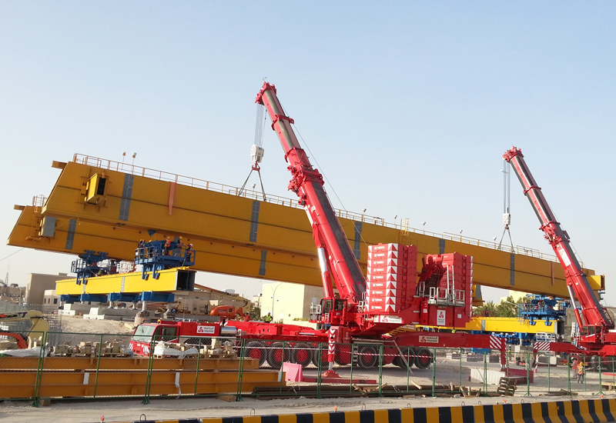
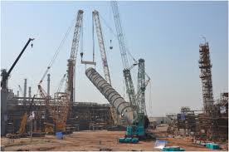
ERIC WONG MACHINERY TRANSPORTATION PTE LTD
28 Kranji Loop #05-03, Kranji Green, Singapore 739571
Tel: 62824175, 62828203, 62826020
GST Reg No. : M2-8923804-2
http://www.ericwong.com
E-mail: ewmtpl@gmail.com
Customer / Tenant Company: KY Sub Assembly Pte Ltd
Site Location: 25 Bulim Square | Approved By: Eric Wong (Director)
Process: Lifting and Moving of Machinery on Platform
Prepared by: Kevin Wong
Last Review Date: 24.02.2025 | Next Review Date: 23.02.2026
9.0 Non-Routine Lifts
9.1 Non- Routine lifting operations will require a more detailed Lifting Plan containing all of the elements as described within these guidelines. The plan will have to be approved by a Responsible Person prior to commencement of any Lifting Operation and any deviation requirement identified from the plan, must also get the approval of the Responsible Person prior to commencement of the lifting operation
Example of Non-Routine Lifting : Tandem Lifting
Example of Non-Routine Lifting : Tilting of Tower/Equipment
10.0 A Non-Routine Lift is a lift which conforms to the following factors:
• Use of two or more Lifting Appliances, including tallying pipe using winch and crane (tandem lift)
• With sensitive, difficult or restricted areas
• Lifts from one offshore vessel to another
• Continuation of a lifting operation with different people
• Lifting of machinery without lifting points
• In environmental conditions likely to affect equipment performance
• Load with unknown / difficult to estimate weight and/or centre of gravity
• Non-standard rigging arrangements
• Load lowered into or lifted from a confined space
• Weight of load in excess of 75% rated load of the load chart

Slide 7
ERIC WONG MACHINERY TRANSPORTATION PTE LTD
28 Kranji Loop #05-03, Kranji Green, Singapore 739571
Tel: 62824175, 62828203, 62826020
GST Reg No. : M2-8923804-2
http://www.ericwong.com
E-mail: ewmtpl@gmail.com
Customer / Tenant Company: KY Sub Assembly Pte Ltd
Site Location: 25 Bulim Square | Approved By: Eric Wong (Director)
Process: Lifting and Moving of Machinery on Platform
Prepared by: Kevin Wong
Last Review Date: 24.02.2025 | Next Review Date: 23.02.2026
Flow Chart for Identification of Routine or Non-Routine Lifting Activities
START
Lifting of equipment more than 80 Tons
Requires Tandem Lifting or Special Crane Configuration. (E.g. Fly-Jib)
Lifting Of Machinery without known Lifting Points
Non-Routine Lift
Lifting more than 75% of Rated Load Chart
Irregular shape / Difficult to estimate weight and Center of Gravity
Routine Lift

Slide 8
ERIC WONG MACHINERY TRANSPORTATION PTE LTD
28 Kranji Loop #05-03, Kranji Green, Singapore 739571
Tel: 62824175, 62828203, 62826020
GST Reg No. : M2-8923804-2
http://www.ericwong.com
E-mail: ewmtpl@gmail.com
Customer / Tenant Company: KY Sub Assembly Pte Ltd
Site Location: 25 Bulim Square | Approved By: Eric Wong (Director)
Process: Lifting and Moving of Machinery on Platform
Prepared by: Kevin Wong
Last Review Date: 24.02.2025 | Next Review Date: 23.02.2026
Identify the needs for the Lifting Operation
Competent Personnel/ Lifting Supervisor to plan the Job Operation
Carry out Risk Assessment. To Ensure all Risk are eliminated or reduced to ALARP
Carry out Risk Assessment (New or Modified according to job scope) Ensure all risk are eliminated or reduced to an ALARP
Competent Personnel (Lifting Supervisor) to establish Lifting Plan
Competent Personnel (Lifting Supervisor) to establish Lifting Plan (New or Modified according to job scope and method of lifting)
Review and Update if Required / Approved by Safety Officer
Appoint team appropriate for the Lifting Operation
Toolbox Meeting to Review Risk Assessment , Lifting Plan, Emergency Response and Contingency Plan. Include all Personnel involved in the Lifting Operation ensure Permit to work is in place.
If a problem is detected.
STOP WORK!
Revert back to earlier position and Review
Risk Assessment – Carry out Management Change if required
Execute Lifting Operation with appropriate supervison
Debrief and Note learning points after Lifting Operation

Slide 9
ERIC WONG MACHINERY TRANSPORTATION PTE LTD
28 Kranji Loop #05-03, Kranji Green, Singapore 739571
Tel: 62824175, 62828203, 62826020
GST Reg No. : M2-8923804-2
http://www.ericwong.com
E-mail: ewmtpl@gmail.com
Customer / Tenant Company: KY Sub Assembly Pte Ltd
Site Location: 25 Bulim Square | Approved By: Eric Wong (Director)
Process: Lifting and Moving of Machinery on Platform
Prepared by: Kevin Wong
Last Review Date: 24.02.2025 | Next Review Date: 23.02.2026
11.0 Competent Person(s)
11.1 Persons who have been appointed or been given the responsibility for planning lifting operations should have sufficient technical, practical and theoretical training, knowledge and experience of the work they are likely to safely plan /assess the lift.
They shall:
Be capable of identifying the hazards and risks associated to lifting operations within their area of work or the environment where the lifting operation will take place.
Be able to select the correct lifting equipment for the work. Understand the characteristics of the lifting equipment they are selecting and the nature of the work it will be carrying out.
Carry out and document risk assessments (lifting operation) or site surveys; have the ability to communicate their findings to those involved in and affected by the lifting operations.
Be able to create method statements or lifting plans and implement safe systems of work for lifting operations.
Where appropriate seek additional support and expertise including the use of external specialists to assist them with the planning of lifting operations. • Have sufficient technical, practical and theoretical training, knowledge and experience of the work being carried out.
Be briefed and instructed on the outcomes of the risk assessment and fully understand the requirements of the safe system of work or lifting plan for the lifting operation to be carried out and an understanding of al those involved in the task.
Supervise all complex or unusual lifting operations.
Monitor a sufficient number of lifting operations to ensure correct working practices are being followed.
Where appropriate direct lifting operations, offering clear instructions to those involved.
12.0 Supervisors
12.1 The appropriate supervision of lifting operations should be proportionate to the level of risk and take into account those involved in a particular lifting operation. Levels of supervision will be determined by the nature or complexity of the work and the competence of those involved in using lifting equipment and assisting with the lifting operation.
Persons who have been authorised to supervise lifting operations shall:
Have sufficient technical, practical and theoretical training, knowledge and experience of the work being carried out.
Be briefed and instructed on the outcomes of the risk assessment and fully understand the requirements of the safe system of work or lifting plan for the lifting operation to be carried out and an understanding of al those involved in the task.
Supervise all complex or unusual lifting operations.
Monitor a sufficient number of lifting operations to ensure correct working practices are being followed.
Where appropriate direct lifting operations, offering clear instructions to those involved.
The overall dimensions (length, width and depth).
Indication of the position of centre of gravity.
The lifting/slinging points
The pickup radius
The final location radius
The height to which the load has to be lifted.
The overall weight (load + all lifting accessories)
Be able to assess changes in circumstances e.g. ground conditions, and where appropriate stop a lifting operation if the risk is unacceptable or if it is considered unsafe to carry on. Referring the concerns to their manager, competent person or person responsible for planning lifting operations

Slide 10
ERIC WONG MACHINERY TRANSPORTATION PTE LTD
28 Kranji Loop #05-03, Kranji Green, Singapore 739571
Tel: 62824175, 62828203, 62826020
GST Reg No. : M2-8923804-2
http://www.ericwong.com
E-mail: ewmtpl@gmail.com
Customer / Tenant Company: KY Sub Assembly Pte Ltd
Site Location: 25 Bulim Square | Approved By: Eric Wong (Director)
Process: Lifting and Moving of Machinery on Platform
Prepared by: Kevin Wong
Last Review Date: 24.02.2025 | Next Review Date: 23.02.2026
13.0 Operators /Riggers /Signalmen
They shall:
Not attempt any lifting operation or use lifting equipment, without prior training/assessment, guidance and appropriate supervision or which is beyond the level of their competency.
Ensure that both routine and complex lifting operations are not undertaken without a suitable and sufficient risk assessment being carried out by a competent person. •
Ensure they are fully understand the lifting equipment, be familiar with how it operates and the proposed lifting operation(s) they have been authorised to do and that safe systems of work, training, guidance and advice are followed at all times. •
Carry out pre-use checks of lifting equipment prior to use, to ensure there are no obvious visual defects. •
Remove faulty or defective equipment from use, clearly record fault or defect on the appropriate documents and report the issue to their manager or person in charge as soon as is reasonably practicable. This includes reporting concerns they may have regarding a lift operation to their supervisor or manager in the first instance and not continuing with the operation. •
Have an understanding of the emergency procedures relating to lifting equipment in use and take part in training and periodic drills, where appropriate.
14.0 Description of Load(s) to be lifted
14.1 Sufficient information must be provided to give a clear, but brief, description that will clearly identify the lift(s) to be undertaken. A separate risk assessment form will need to be completed for every time the crane is moved to a new position, unless the risk assessment has taken into account the hazards associated with all positions.
14.2 Details of Load(s) to be lifted
14.3 To gather the load/loads to be lifted. The customer or client requiring the lift must provide the Competent Person with full details of all loads to be lifted. Details of each load to be lifted must be entered on the risk assessment form. The Competent Person must carefully consider all the loads to be lifted and ensure that sufficient information is provided and recorded to enable other persons to see how the lifts are to be performed in a safe manner.
14.4 Load Crucial Information. No load must be lifted without the following crucial information:
• The load weights
14.5 Load(s) Weight(s) Including Lifting Gear
14.6 To ensure the weight of the load and information should be given at the earliest point in the planning stage, so that from this information, your crane selection will be made and all the planning around it. The weight of the load must be accurate.
14.7 The load dimensions shall be recorded, this will also help in the planning of the lift, particularly to establish boom clearance, calculate required clearances when in restricted and confined areas, it also allows calculation to be completed on wind sail area giving a maximum wind speed that crane can operate in.

Slide 11
ERIC WONG MACHINERY TRANSPORTATION PTE LTD
28 Kranji Loop #05-03, Kranji Green, Singapore 739571
Tel: 62824175, 62828203, 62826020
GST Reg No. : M2-8923804-2
http://www.ericwong.com
E-mail: ewmtpl@gmail.com
Customer / Tenant Company: KY Sub Assembly Pte Ltd
Site Location: 25 Bulim Square | Approved By: Eric Wong (Director)
Process: Lifting and Moving of Machinery on Platform
Prepared by: Kevin Wong
Last Review Date: 24.02.2025 | Next Review Date: 23.02.2026
14.8 The weight of the load must include every piece of lifting gear involved in the lift from the hook block downwards, ropes, beams, shackles, frames, slings etc.
14.9 Every load lifted should in the first instance be lifted slowly from the ground, should it start to exceed the given weight it must be placed back on the ground and the Responsible Person/ Competent/ Person must then take whatever actions are required to re-plan the lifting operation.
15.10 Centre of Gravity (CG) of the load
15.1 To ensure that every lifting operation is under control and free of unplanned movement, the CG must be known. In simple lifting terms with balanced loads the CG is generally in the middle, this point will always be directly below the centre line of the crane hook block when slung.
16.0 Crane Selection
16.1 Using the previously gathered information in conjunction with crane manufactures duty charts it will allow the selection of a crane that is suitable with sufficient capacity to safely execute the lifting operation.
16.2 Details of the Crane
Details of the preferred crane(s) to be used must be recorded within the Method Statement and must include:
The make and model:
Capacity
Jib length (plus fly /luffer jib with offset where required);
Outrigger Spread;
Outrigger Load
Counterweight/Super-Lift Counter Weight (where required)
17.0 Ground & Outriggers
17.1 When lifting on outriggers the outrigger beams and jacks must be extended in accordance with the manufacturer’s instructions for the crane. The Competent Person must ensure that there is sufficient space at the crane siting location for this to be achieved. The crane rated capacity indicator must be set in accordance with the manufacturer’s operating instruction
17.2 A normal routine & non-routine lifting operations with hydraulic mobile cranes must have outriggers fully blocked out using load bearing mats / Metal Plate.
17.3 Mobile/lorry /crawler /lorry Cranes are designed to walk but careful and particular attention must be given to the ground conditions. At the time of the survey ground conditions should be established. In many cases it will be necessary to lay down large wooden or steel mats for the Crane to move around a site.

Slide 12
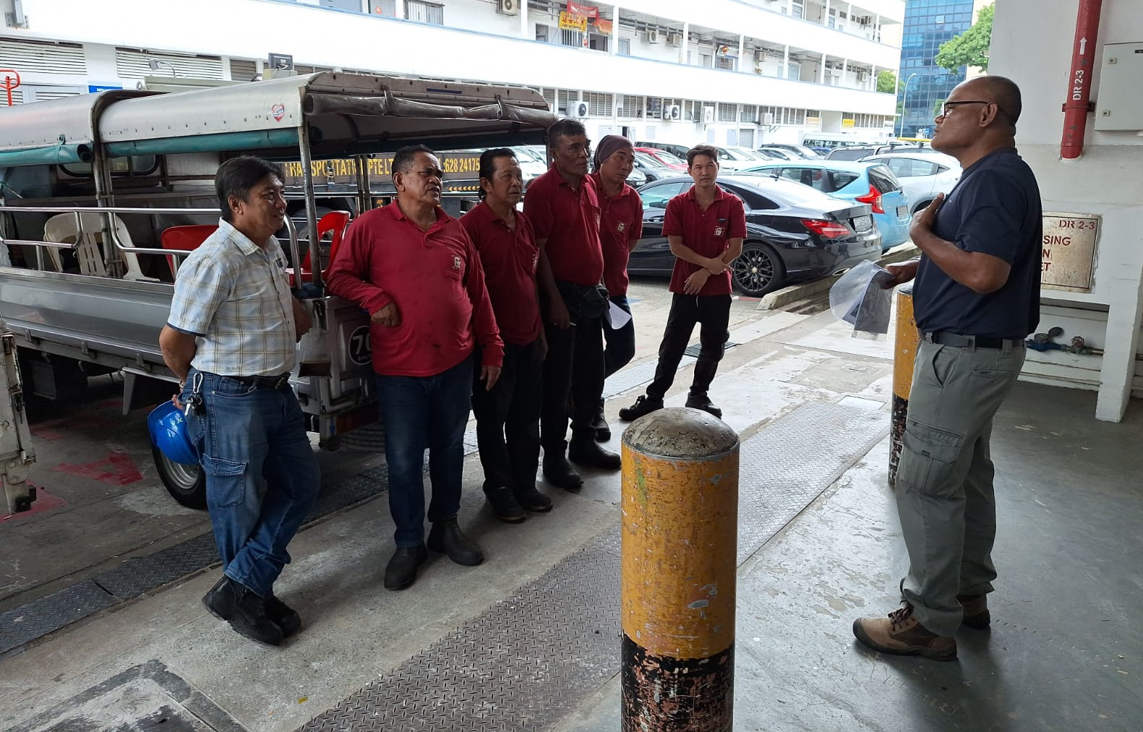
ERIC WONG MACHINERY TRANSPORTATION PTE LTD
28 Kranji Loop #05-03, Kranji Green, Singapore 739571
Tel: 62824175, 62828203, 62826020
GST Reg No. : M2-8923804-2
http://www.ericwong.com
E-mail: ewmtpl@gmail.com
Customer / Tenant Company: KY Sub Assembly Pte Ltd
Site Location: 25 Bulim Square | Approved By: Eric Wong (Director)
Process: Lifting and Moving of Machinery on Platform
Prepared by: Kevin Wong
Last Review Date: 24.02.2025 | Next Review Date: 23.02.2026
18.0 Access & Lifting Location
18.1 The Competent Person during his survey should take particular note and record the site ground surface conditions on at least 2 occasions, the first relates to access for the crane and transport vehicles (boom/ ballast/counterweight carriers) to the site location and the second being the actual location where the crane will be located when lifting the load/s.
18.2 The Competent Person must be satisfied with the space provided and the access route to be used, also the nature of the surface (e.g. blacktop, hard-core, concrete). For clarity, the route can be shown on the site plan
19.0 A Pre-Start Meeting
19.1 Start any lifting operation until all concerned have been briefed in a Pre-Start Meeting, ensuring that they understand their role and responsibilities and that they have signed onto the Permit-to-Work or record of attendance at the Pre-Start Meeting.

Slide 13
ERIC WONG MACHINERY TRANSPORTATION PTE LTD
28 Kranji Loop #05-03, Kranji Green, Singapore 739571
Tel: 62824175, 62828203, 62826020
GST Reg No. : M2-8923804-2
http://www.ericwong.com
E-mail: ewmtpl@gmail.com
Customer / Tenant Company: KY Sub Assembly Pte Ltd
Site Location: 25 Bulim Square | Approved By: Eric Wong (Director)
Process: Lifting and Moving of Machinery on Platform
Prepared by: Kevin Wong
Last Review Date: 24.02.2025 | Next Review Date: 23.02.2026
Sequence of Lifting operation
20.1 Crane mobilize to site must be equipped with certified LM certificate and checklist duly endorsed by a mechanical professional engineer.
20.2. All cranes must be re-inspected by mechanical professional engineer every 12 months to ensure cranes are in good working condition.
20.3 A qualified lifting supervisor must be present to supervise every lifting operation.
20.4. All cranes must be operated by qualified persons.
20.5. Before any daily operation, daily inspection of crane must be carried out by operator to check the wire ropes, blocks, hooks and overloading device, etc. as listed in the checklist to ensure they are in working condition.
20.6. Investigate the site headroom, site clearance and site access by lifting supervisor.
Procedure Step
Do not wrap the hoist load chain or wire rope around the load. The load shall be attached to the load hook with slings or other approved devices
Do not use hoist for side pulls
Use tag lines to control free swinging loads
Where possible limit access to the areas where the hoist is in operation
For general lifting never use a chain when it is possible to use wire rope. The failure of a single link of chain can result in a serious accident, but wire rope is frequently composed of 114 wires all of which must fail before the rope breaks. Wire ropes provide reserved strength and a chance to notice a hazard, chains my not.
Do not lift loads over people
Do not exceed hoist capacity
Never use the upper limit switch as an operating control

Slide 14
ERIC WONG MACHINERY TRANSPORTATION PTE LTD
28 Kranji Loop #05-03, Kranji Green, Singapore 739571
Tel: 62824175, 62828203, 62826020
GST Reg No. : M2-8923804-2
http://www.ericwong.com
E-mail: ewmtpl@gmail.com
Customer / Tenant Company: KY Sub Assembly Pte Ltd
Site Location: Singapore Mint | Approved By: Eric Wong (Director)
Process: Lifting and Moving of Machinery on Platform
Prepared by: Kevin Wong
Last Review Date: 24.02.2025 | Next Review Date: 23.02.2026
Loads should be lifted smoothly without sudden acceleration or deceleration
Always inch the hoist into the load to reduce shock loading and provide warning if the load is anchored
While any employee is on the load or hook of an overhead or gantry crane there shall be no hoisting, lowering or travelling no matter how they are supported, unless the personnel are supported on specially designed platforms using management approved procedures
Check that the load is well secured, properly balanced and hoist checked for vertical drift before lifting it more than a few inches. If vertical drift is present stop hoisting operations and check for vertical drift.
Check for drift with a rated load on the hook, while lifting the load. If the load does not stop within 2” when control is released, check and adjust the load brakes to limit travel to no more than 1” or less. If the brake cannot be adjusted to limit travel to 1” or less, than the brake shoes or disc needs to be replaced
Verify that the load chain or rope is not kinked, twisted or snagged against obstructions as load is being lifted. On multi part hoists, verify that the load chains are not twisted about each other. This occurs when the lifting block is turned through the chain during handling or if they are not properly aligned when initially installed
Operate the hoist cautiously, especially when lowering, so that the load is kept under control
Do not lower below the point where less than two full wraps of wire ropes remain on the hoisting drum
Do not operate hoist when the chain or cable is not properly seated in its grooves
Anytime the hoist is lowered to a slack line condition check the revving on pulleys and drums before making the next lift. Sheaves carrying ropes which can be momentarily unloaded shall be provided with close fitting guards or other suitable devices to guide the rope back into the grooves when the load is reapplied, In addition sheaves in the bottom block shall be equipped with close fitting guard that prevents ropes from becoming fouled when the block is lying on the ground with the rope loose
All running sheaves shall be equipped with means for lubrication. Permanently lubricated sealed bearings meet this requirement
Hoist brakes shall be tested each time a load above 90% of the rated load is handled
Daily Inspection Checklist
Slings, fastenings and attachments shall be inspected daily for damage or defects by a person designated by management.

Slide 15
ERIC WONG MACHINERY TRANSPORTATION PTE LTD
28 Kranji Loop #05-03, Kranji Green, Singapore 739571
Tel: 62824175, 62828203, 62826020
GST Reg No. : M2-8923804-2
http://www.ericwong.com
E-mail: ewmtpl@gmail.com
Customer / Tenant Company: Singapore Mint
Site Location: Singapore Mint | Approved By: Eric Wong (Director)
Process: Lifting and Moving of Machinery on Platform
Prepared by: Kevin Wong
Last Review Date: 24.02.2025 | Next Review Date: 23.02.2026
Work Method Statement for Lifting Operation:
The following work to be carrying out prior to the lifting operation:
Lifting Area to be Fully Barricaded for Safety of Passer-by with Signage of Lifting Operation Displayed.
Lifting Supervisor to Discuss with Crane Operator of Cargo or Equipment Weight for Crane Operator to verify Distance and Parking Location.
Crane Operator to Ensure all ground condition are good strong.
Outrigger to be rested on Metal Plates to Spread load.
Lifting Wire and Slings are to be in Good Condition and LG Certs are all valid checked by Supervisor.
Supervisor is to check SWL is Sufficient to Support Cargo / Equipment Weight
All Workers involved will have to brief and sign on the Tool-Box Meeting form before work commence
Lifting Team will be wearing vest with their roles stated at the back of their Red Luminous Vest to perform their roles. Road Marshal will be parked out of hoisting area to control traffic and to stop unauthorized entry of personnel into lifting area.
Team will lay Platform on Uneven Ground to Facilitate the Machine to be transported out of the factory on a more level position.
After Laying of the Platform machinery will be jacked up using Hydaulic Pump System to Insert Rollers underneath the Machine. After inserting roller in Shift Machinery out of the Premises onto the Platform. Riggerman to reach the hoisting point to Secure Wire Rope / Slings with Crane before lifting
Tagline is to be tied at a machine secured area which to be defined on site.

Slide 16
ERIC WONG MACHINERY TRANSPORTATION PTE LTD
28 Kranji Loop #05-03, Kranji Green, Singapore 739571
Tel: 62824175, 62828203, 62826020
GST Reg No. : M2-8923804-2
http://www.ericwong.com
E-mail: ewmtpl@gmail.com
Customer / Tenant Company: KY Sub Assembly Pte Ltd
Site Location: 25 Bulim Square | Approved By: Eric Wong (Director)
Process: Lifting and Moving of Machinery on Platform
Prepared by: Kevin Wong
Last Review Date: 24.02.2025 | Next Review Date: 23.02.2026
22.0 Emergency procedures
22.1 In case of un-usual noise in the mechanical system, STOP the crane immediately and report the supervisor.
22.2 In case accident / incident call supervisor / manager immediately.
22.3 Hotline for Police 999 / SCDF 995
References :
1. Workplace Safety And Health Act
2. Workplace Safety And Health (General Provisions) Regulations
3. Workplace Safety And Health (Construction) regulations 2007
4. Workplace Safety And Health (WAH) regulations 2013
5. Code of Practice for Safe Lifting Operations at the Workplace
6. Singapore Standard SS 559: 2010 Code of Practice for Safe Use of Tower Cranes

